Slide 1
Using Chatgpt for Coding
Presented by Ellie Bavuso

Slide 2


Ellie Bavuso: My Background
Honors, Junior, Bio major, President of the Association of Students with Disabilities & Chronic Conditions (ASDCC)
CCTR & HSURP fellow on the MCV campus designing virtual reality therapeutics for neurodevelopmental disorders (ASD, ADHD, SLD, etc)
I work in the Department of Pharmacotherapy & Outcomes Sciences
I currently work primarily with Unity and Blender, & the programming languages I’m most comfortable with are C# and Java

Slide 3
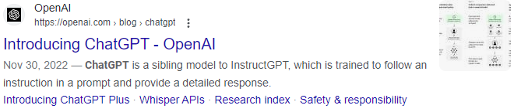
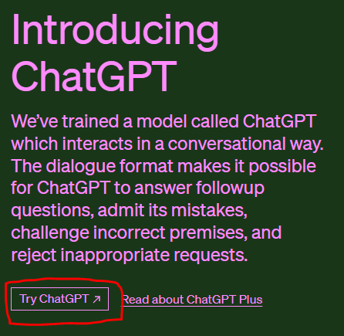
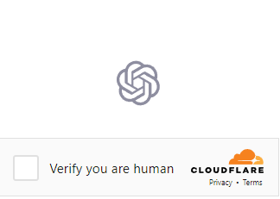
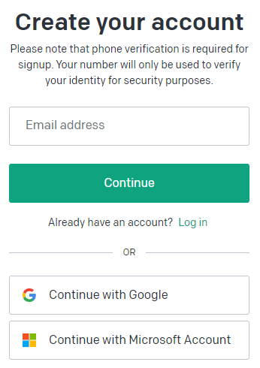
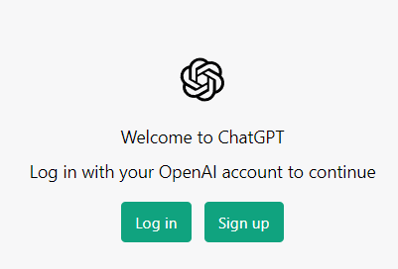
Step 1: Accessing Chatgpt
Start by Googling Chatgpt
Select the first option by OpenAi
Once on the webpage, click ‘TryChatGPT’
Verify that you are human
Sign up or log in
After logging in, you will be shown a notification stating that “This is a free research preview.”
Click ‘Next’ and click through, and after you hit ‘Done’, you will be brought to the New Chat page

Slide 4
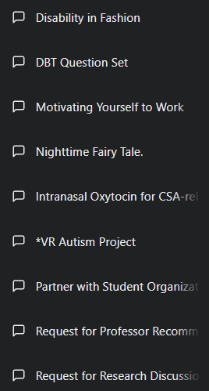
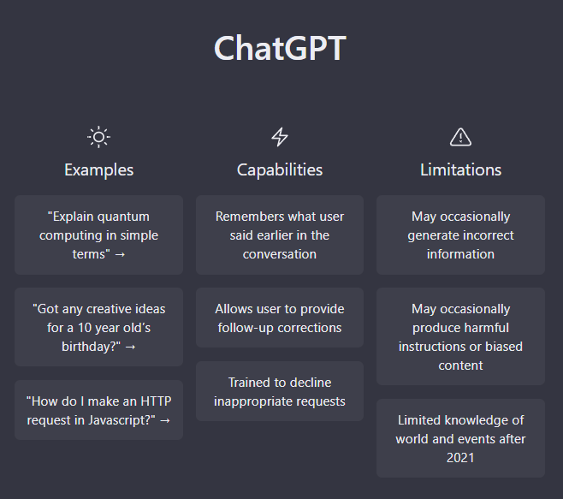
Step 2: Prompt Organization
Prompts are organized by the order you create them in
Chatgpt remembers things you’ve sent earlier in the conversation so make sure you send all of your prompts within the same chat instead of creating new chats
You can add a special symbol such as ~, *, #, or ^ to differentiate your coding chat if you have a lot of projects, but note that this will not send your project to the top of the list

Slide 5



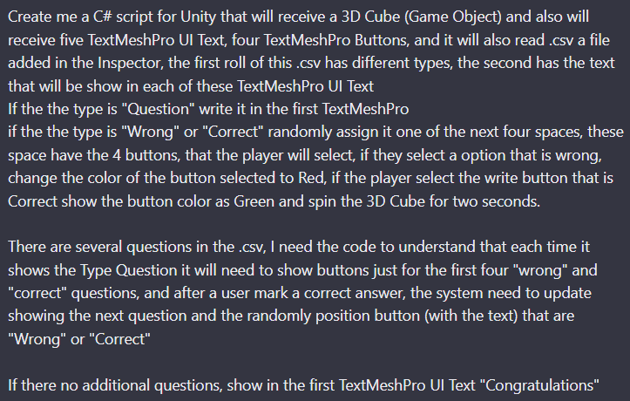
Step 3: Designing your Prompt
Like many systems, Chatgpt’s answers are only as good as the prompts you give it
Most often, you will have to try several combinations of asking the same question before you receive the full answer you were looking for (particularly when creating code)
A helpful keyboard shortcut to know is shift+enter to go down a line in the chat box.
If you just hit enter, it will send your request to the AI
This is just useful for organization & when you have several things to copy and paste into the chat box

Slide 6
A short problem!
I want ChatGPT to tell me what Python libraries to use to schedule an email to send at 10am on Saturday, March 18th to all people who still haven’t checked in for BNFOTHON. The list of people is stored in an Excel spreadsheet.
Chatgpt gave me these four libraries to use. Based on the descriptions it gave, which one probably is least useful?
Hint: Do we need to write data into our Excel file? Any of these libraries have duplicative functions?
Pandas:
Pandas is a powerful library for data manipulation and analysis. You can use it to read in your Excel file and manipulate the data in a DataFrame.
Schedule:
Schedule is a Python library that allows you to schedule functions to run at specific times. You can use it to schedule the email sending function to run at 10am on Saturday, March 18th.
smtplib:
smtplib is a Python library that provides a way to send email messages using Simple Mail Transfer Protocol (SMTP). You can use it to send the email to the people who have not checked into the event.
Openpyxl:
Openpyxl is a Python library to read/write Excel 2010 xlsx/xlsm/xltx/xltm files. You can use it to read/write the Excel file containing the data you want to process.

Slide 7



Using Chatgpt for Brainstorming & Copy-editing
You can use Chatgpt to determine what libraries or frameworks will help you achieve your goal
It can help you determine the base structure of your program
Can use it to educate yourself on programming language syntax or use of a specific library for a task
It might give you some extraneous results, so proofread and put your results through diffchecker!

Slide 8
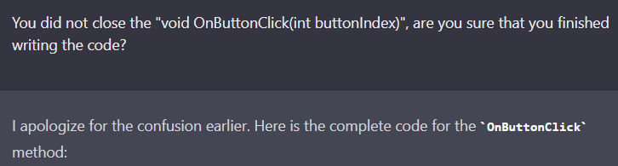
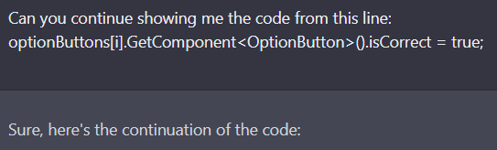
Troubleshooting your Prompts
When you’re writing long scripts, sometimes Chatgpt will finish writing its response without finishing the script
You can tell this simply if it doesn’t end with the appropriate amount of brackets {
You can fix this by asking to continue from this line: [ctrl+v last line of response]
Sometimes, it will also explain a code error to you instead of updating the code for you. This can be fixed with some easy coaxing.
Don’t be afraid to ask Chatgpt to fix errors you notice or inconsistencies you find, or even just to change things to your preference

Slide 9
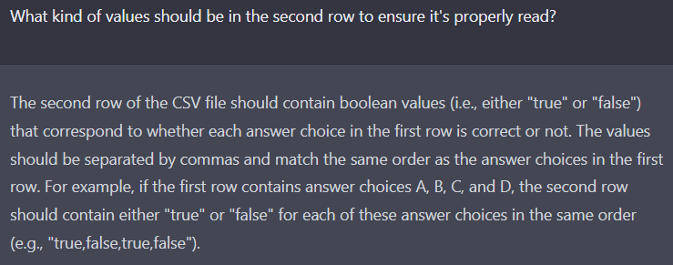
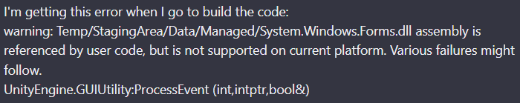
Troubleshooting Code Errors with Chatgpt
Make sure you specify to Chatgpt which software you’re working in so it uses the correct libraries
Generally, you can state “I’m getting this error: [code]” and get a good idea of where to start looking
You can ask Chatgpt to go into more detail about certain suggestions
You can also describe parts of the code that are not functioning as intended during testing and ask Chatgpt to fix the code

Slide 10
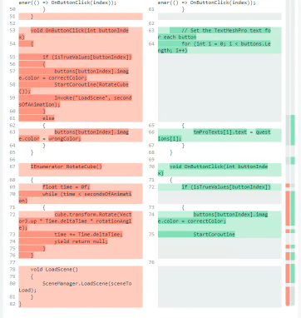
Keeping Track of What Chatgpt Changes
Computed Diff (diffchecker.com) is a great free resource that allows you to compare the initial text/code you fed into Chatgpt with the newly created code
This makes it easier to visualize the changes and allows you to pick and choose which edits made by Chatgpt to keep
Protects you from script errors due to Chatgpt forgetting to copy over certain libraries or sections of code appearing in the original text
Allows you to copy over code comments that Chatgpt may have written out

Slide 11
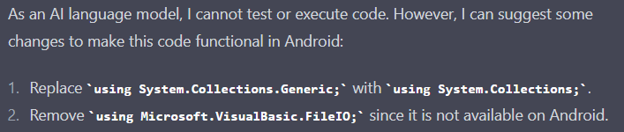
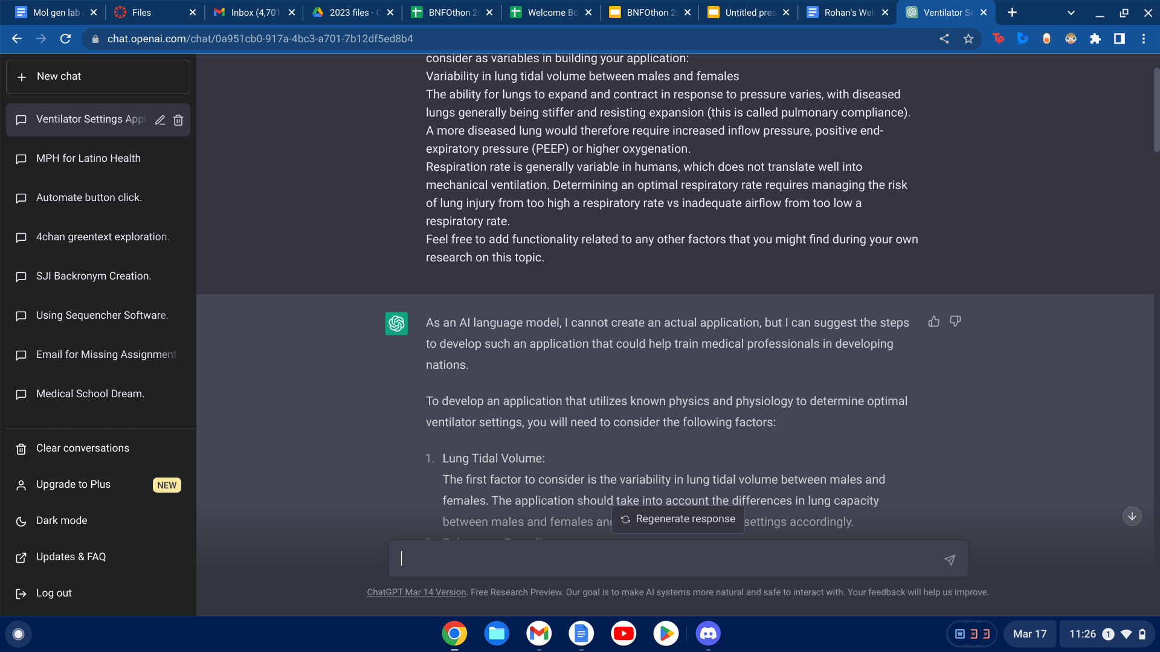
What ChatGPT can’t do
Putting one of your prompts into the program likely won’t get you a meaningful output.
Inputting broad requests usually won’t get you anywhere either
Treat it like you’d treat one of our Mentors
Ask specific requests
Have a game plan!
It is also limited in information past 2021- this means you need to be mindful of what year software you’re using!
There is also an ~150 line limit for pasting code into the chat box
Sometimes it can’t detect really basic errors in its codes, like using 2 incompatible libraries
Notes:
I put in prompt 6 into chatgpt, it just rewrote prompt 6 for me, thank god.

Slide 12
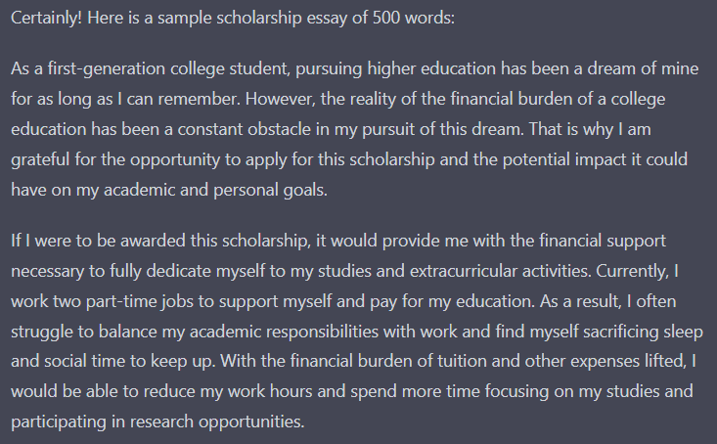
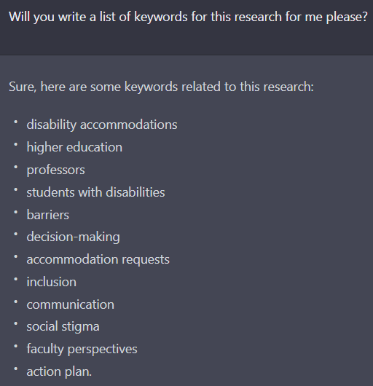
Using ChatGPT for Your Presentation
ChatGPT can help you write your presentation script, come up with effective keywords, and use more academic language throughout your presentation.
ChatGPT has a very good ability to BS when it doesn’t know something
This is both good and bad
AI have a propensity to write long sentences with similar sentence structure throughout a paragraph
This makes it easy to spot AI writing, if you know what you’re looking for
Some mistakes are made-Try putting the US constitution through an AI language detector
As always- ChatGPT will assist you in elevating your presentation!

